Slide 1
Androids Dream of Electric Mice: Navigating a maze using Anki’s Cozmo
Maxwell James McMahon

Slide 2

Goal:
We wished to demonstrate maze-pathing algorithms in a visual and exciting manner. To achieve this end we used Anki’s Cozmo robot, along with its python-based SDK
Using Cozmo, we demonstrated the following algorithms:
Wall Follower
Random Mouse
Pledge

Slide 3
Algorithms

Slide 4
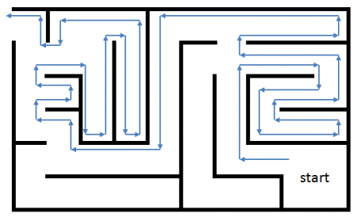
Wall Follower
Move alongside wall until maze is exited
Only works with simply-connected mazes
Mazes in which all walls are either connected to each other or the boundary
Image credit:

Slide 5
Algorithm implementation: wall follower
Left-hand wall Follow:
Advance into maze
Loop until maze is exited:
Rotate left and see if a wall is present, if there is not, move forward
If wall was detected in previous step, rotate right and check if there is a wall in front of robot, if there is not, move forward
Otherwise, Turn right again and check if there is a wall in front of robot, if there is not, move forward.

Slide 6
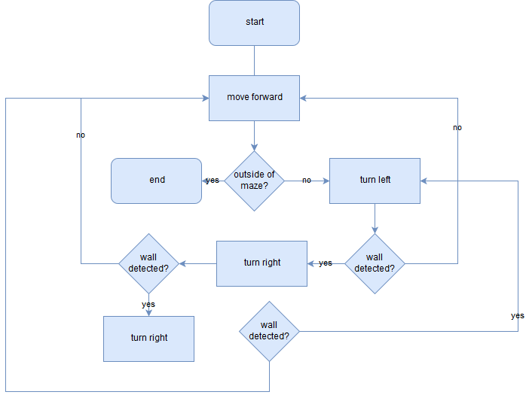

Slide 7
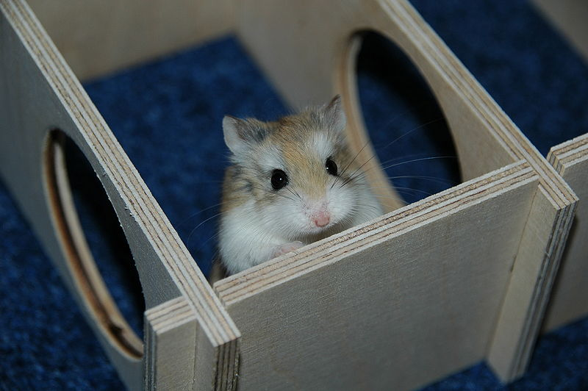
Random Mouse algorithm
When junction is encountered, head down a randomly chosen path
Continue until exit is reached
Simple, yet inefficient
Image Credit

Slide 8
Algorithm implementation: Random Mouse
Surprisingly complex to implement!
Advance into maze
Outer loop: ends when exit is found
Check if maze is completed
Reset left, right, and center flags to 1
Inner Loop: ends when valid direction is picked:
Choose random number integer between 0 and 2
Select path based on result (0 for center, 1 for left, 2 for right
If chosen direction’s flag is 1 turn that direction
See if there is a wall, if there isn’t advance and exit inner loop. Otherwise, set that direction’s flag to 0

Slide 9
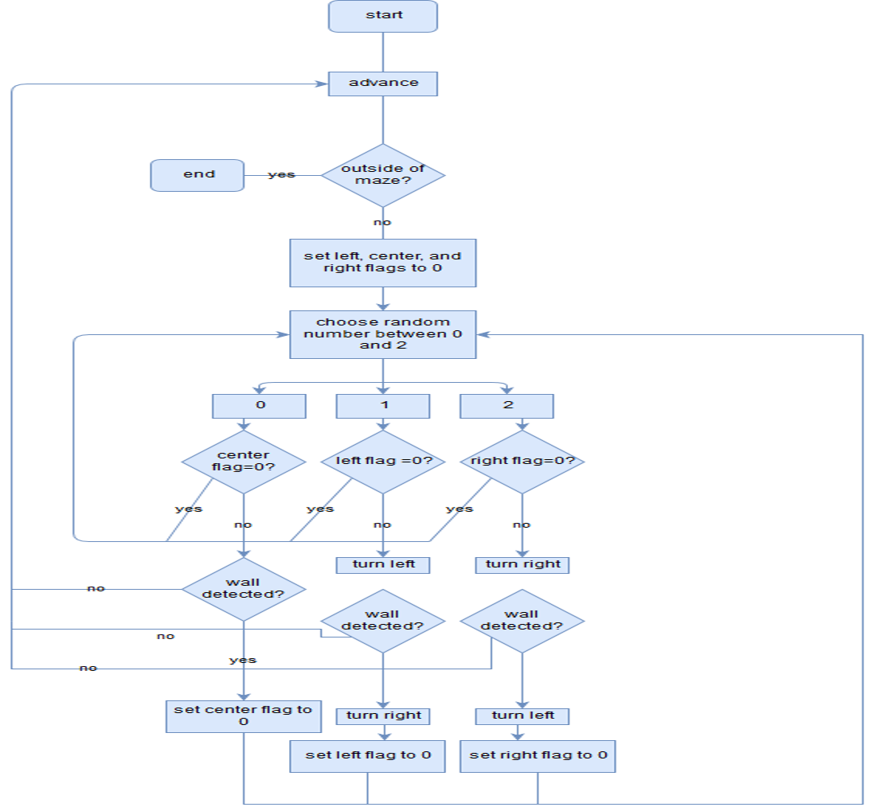

Slide 10
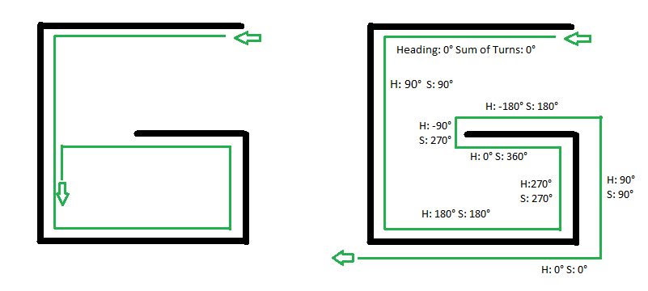
Pledge
Advance until obstacle is encountered
Place “hand” on wall
Change heading and number of turns after each turn
If heading and turns both=0 return to step 1
Otherwise, continue following wall
Compares a left-wall follower to pledge, heading and sum of turns helps avoid getting stuck.
Image Credit

Slide 11
Algorithm Implementaion: Pledge
In a directly connected graph, pledge functions as a more complex wall-follower
Advance
OuterLoop perform until maze is exited
Detect Obstacle
If obstacle detected: set heading and turns to 0. Turn right and subtract 90 from heading and 1 from turns. perform Inner loop until heading and turns are equal to zero
Inner loop on next slide
Advance and check for completion

Slide 12
Algorithm Implementaion: Pledge (con’t)
Inner Loop: loop until heading=0 and turns=0
Turn left, increase turns by 1 and heading by 90. if there is no wall, advance
If there was a wall in 2, turn right, reducing heading by 90, and turn by 1, if there is no wall advance
If there was a wall in 3, perform 3 a second time
If at any point, the heading =360 or -360, reset heading to0

Slide 13
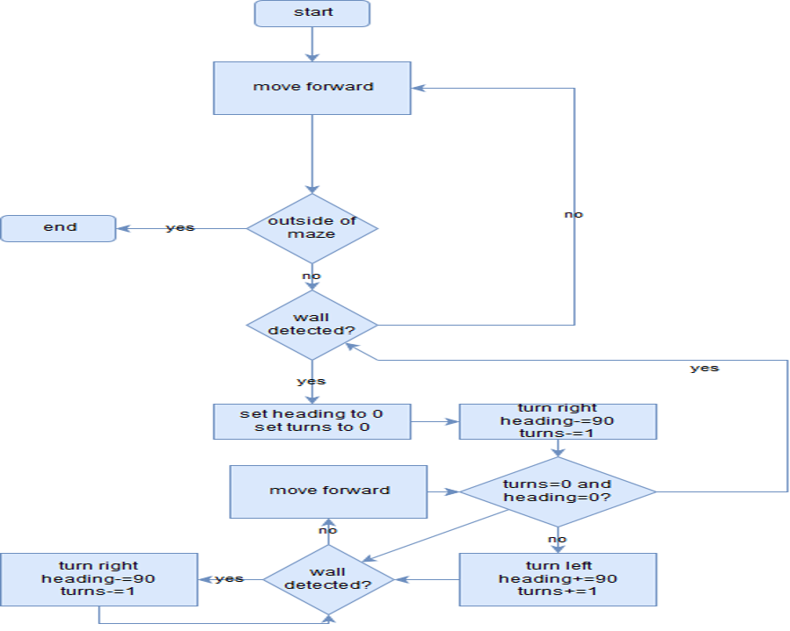

Slide 14
Structure

Slide 15
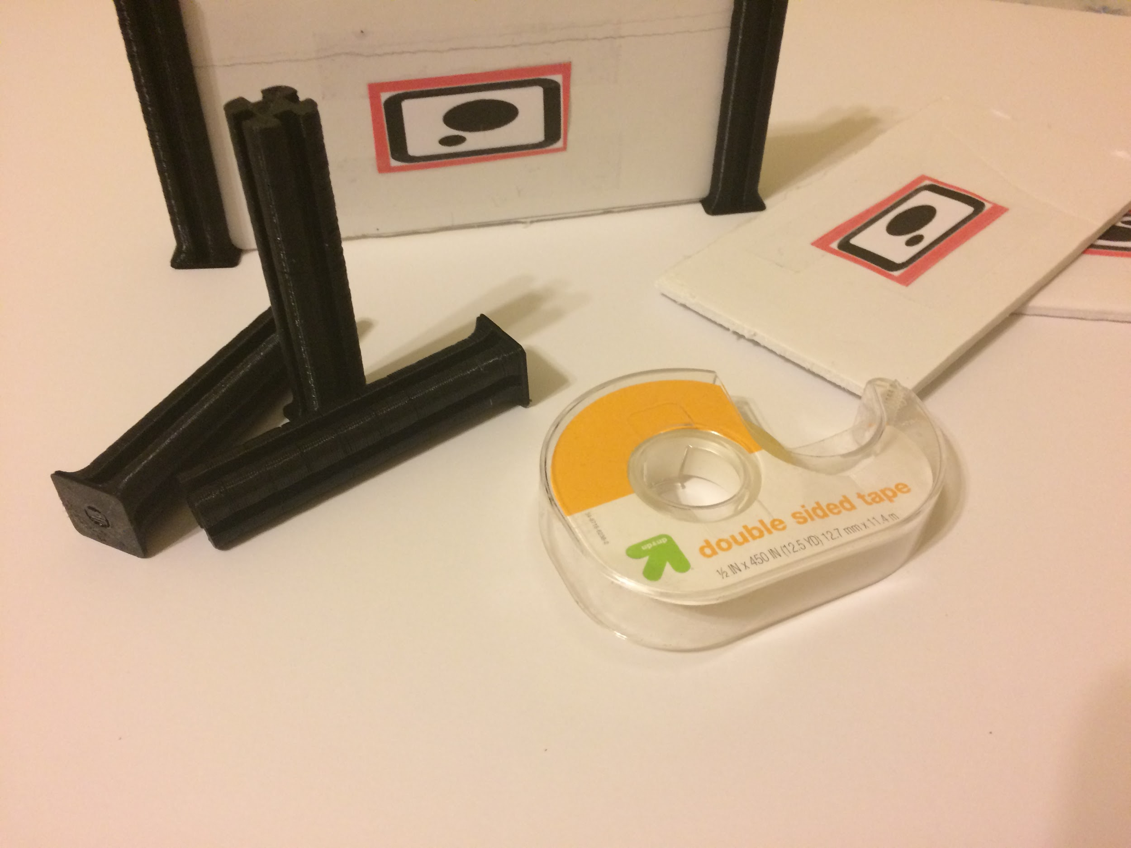
Maze Construction
The mazed is modular, and consists of a foam board base, foam board walls, and 3d printed corner pieces.
Walls are labeled with a marker image so that they are recognized by Cozmo
Some pillars are attached to board with sticky tape for increased stability

Slide 16
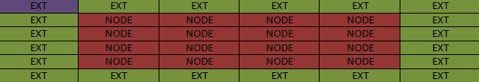
Maze Structure
Maze Class
Add: creates new node, pins to end of array
Get: returns a Node at a specific index
wallOff: severs connections between nodes (such as when a wall is found)
Not pictured
create : creates maze given number of columns and rows
Maze Layout: Exts are exterior cells. The root at 0,0 is labeled in purple

Slide 17
Maze Structure Cont.
Node:
retExt: returns whether or not a node is an exterior piece
retMarks: return Mark Count
iterateMarks: increases mark Count
Sever: cuts connections between nodes, used when walls are detected

Slide 18
Navigation Structure
NavStat Class:
getOrient: returns orientation
getRow: returns current row
getCol: returns current column
rotate90CW and rotate 90CCW: determines orientation of robot after a 90 degree clockwise/ counterclockwise turn
Advance:moves forward based on orientation, returns whether movement is valid
Retreat: Moves backward based on Movement, returns if movement is valid

Slide 19
Navigation Movement
DriveImplementaion Inner Class (required b/c oddities of SDK)
rotate90CW: performs NavStat rotate90CW, and rotates robot 90 degrees CW
Rotate 90CCW: Reverse of rotate 90CW
Advance: performs NavStat advance, and moves robot forward if movement is valid (no wall)
Retreat: reverse of advance
Sense: uses camera to determine if there is a wall in front of cozmo, Cozmo backs up to in order to see entire marker, returns 1 if wall is found, otherwise returns 0
CourseCorrection: used for turning, keeps track of discrepancies between actual orientation and supposed orientation of bot, fixes after certain tolerance

Slide 20
Demonstration

Slide 21
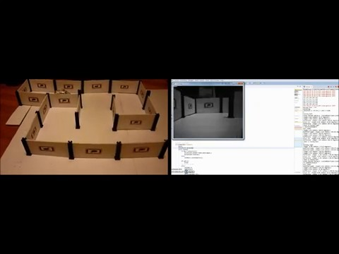
Random Mouse

Slide 22
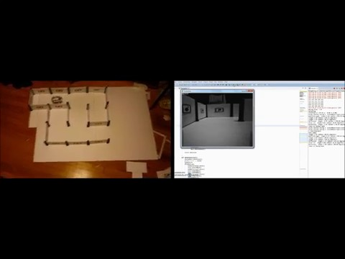
Wall-Follower

Slide 23
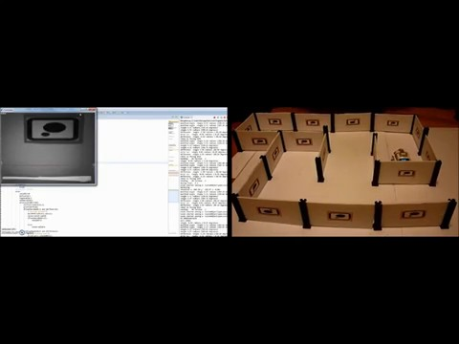
Pledge

Slide 24
Future Work
Increased size mazes
GUI for maze parameters
Following a line with cliff sensor for course correction
Implement Tremaux’s algorithm
In-depth timings and efficiency ratings

Slide 25
Thanks/Acknowledgments
Dr. Marietta Cameron: Faculty Advisor
Dr. Kenneth Bogert: 3d printing support
Hann Henson: 3d printing and modeling support
Max Dennis: filming support
Dr. Adam Whitley: advisor
Makeblock forum user Chuck McKnight: pillar model

Slide 26
Image Credit
Maze animation created by wikimedia commons user Grj23, licensed under Attribution Share-Alike 4.0
Cozmo Images are property of Anki
Mouse Image created by wikimedia commons user Bullet, licensed under Attribution Share-Alike 3.0
Wall Follower Image:
Pledge Image: created by wikimedia commons user Randomperson321 licensed under Attribution Share-Alike 4.0 international
Flow Charts Made with draw.io

